Slide 1
3413ICT Network Security
Lecture 2B: Authentication
Dr V. Muthukkumarasamy
B.Sc.Eng (Hons) (Peradeniya), PhD (Cantab), MIEE, MIEEE
Notes:
Griffith University, School of ICT
2010/1
3400ICT Information System Security
1
Griffith University, School of ICT
2010/1
3400ICT Information System Security
1

Slide 2
Previous Lecture..
Have considered:
Public-key cryptography
RSA, including algorithm and security
Distribution of public keys
Public-key distribution of secret keys
Diffie-Hellman key exchange
Elliptic Curve cryptography
Message Authentication Codes

Slide 3
Today’s Objectives
To briefly understand the properties of Hash functions
To learn digital signatures
To study digital signature algorithms
To learn digital signature standard

Slide 4
References
Cryptography and Network Security: Principles and Practice, 6th ed.,
William Stallings, Chapters 11-13
Applied Cryptography, 2nd ed., Bruce Schneier Chapter 18

Slide 5
Hash Functions
To condense arbitrary message to fixed size
Hash functions can be public and not keyed
Hash functions are used
to detect changes to message, and
to authenticate identity, etc.
Usually used with other techniques (such as, digital signature)

Slide 6
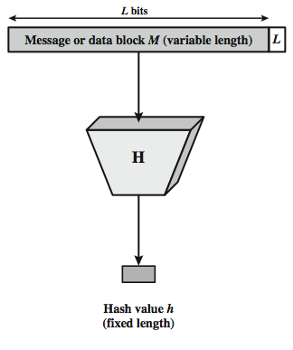
Hash Function Operation
Notes:
Stallings Figure 11.1 depicts the general operation of a cryptographic hash function. Typically, the input is padded out to an integer multiple of some fixed length (e.g., 1024 bits) and the padding includes the value of the length of the original message in bits. The length field is a security measure to increase the difficulty for an attacker to produce an alternative message with the same hash value.
6

Slide 7
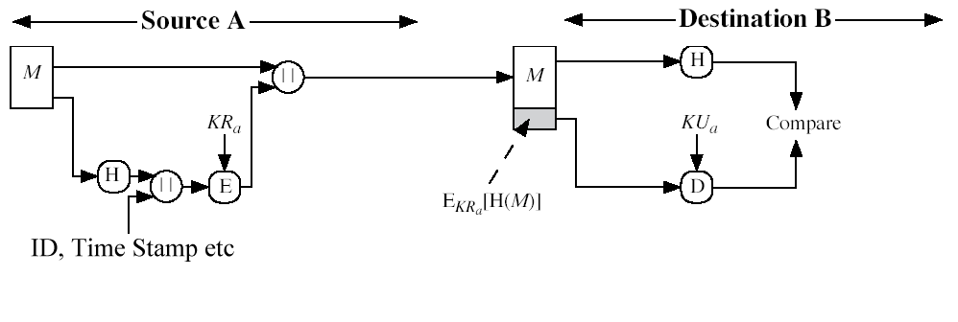
Hash Functions & Digital Signatures
(based on Stallings Fig 11.2 c)

Slide 8
Hash Function Properties
A hash function produces a fingerprint of some file/message/data
h = H(M)
Condenses a variable-length message M to a fixed-sized fingerprint
Assumed to be public (not a cipher)

Slide 9
Requirements for Hash Functions exam questions
Can be applied to any sized message M
Produces fixed-length output h
Is easy to compute h=H(M) for any message M
Given h,it is infeasible to find x such that H(x)=h
One-way property
Given x, it is infeasible to find y,s.t. H(y)=H(x)
Weak collision resistance
Infeasible to find any x,y such that H(y)=H(x)
Strong collision resistance
Notes:
These are the specifications for good hash functions. Essentially it must be extremely difficult to find 2 messages with the same hash, and the hash should not be related to the message in any obvious way (ie it should be a complex non-linear function of the message). There are quite a few similarities in the evolution of hash functions & block ciphers, and in the evolution of the design requirements on both.

Slide 10
Simple Examples
Bit-by-bit exclusive-OR (XOR) of every block
It produces a simple parity check bit
Reasonably effective as data integrity check
Partition the message into n blocks. For each block, compute the parity check bit as above
For these n parity check bits, rotate each one to left by one position
XOR the sequence into the final hash value
Notes:
To get some feel for the security considerations involved in cryptographic hash functions, we present two simple, insecure hash functions in this section. One of the simplest hash functions is the bit-by-bit exclusive-OR (XOR) of every block, which can be expressed as shown. This operation produces a simple parity for each bit position and is known as a longitudinal redundancy check. It is reasonably effective for random data as a data integrity check. Each n-bit hash value is equally likely. Thus, the probability that a data error will result in an unchanged hash value is 2^{–n}. With more predictably formatted data, the function is less effective. For example, in most normal text files, the high-order bit of each octet is always zero. So if a 128-bit hash value is used, instead of an effectiveness of 2^{–128}, the hash function on this type of data has an effectiveness of 2^{–112}.
A simple way to improve matters is to perform a one-bit circular shift, or rotation, on the hash value after each block is processed. Although this second procedure provides a good measure of data integrity, it is virtually useless for data security when an encrypted hash code is used with a plaintext message. Given a message, it is an easy matter to produce a new message that yields that hash code: Simply prepare the desired alternate message and then append an n-bit block that forces the new message plus block to yield the desired hash code.
10

Slide 11
Block Ciphers as Hash Functions
One can use block ciphers as hash functions
Set H₀= initial value
Compute: H_{i} = E[M_{i} , H_{i-1}] and ,use final block as the hash value
With DES resulting hash is too small (64-bit), which is not strong enough against
Birthday attack, and
“Meet-in-the-middle” attack

Slide 12
Secure Hash Algorithm (SHA)
SHA was designed by NIST & NSA in 1993, revised 1995 as SHA-1
Secure Hash Standard (SHS): US standard for use with signature scheme
Note: The algorithm is SHA, the standard is SHS
Produces 160-bit hash values
Notes:
SHA is one of the newer generation of hash functions, more resistant to cryptanalysis, and now probably preferred for new applications.

Slide 13
Revised Secure Hash Standard
NIST have issued a revision of SHS
Adds 3 additional hash algorithms
SHA-256, SHA-384, SHA-512
Designed for compatibility with increased security provided by the AES cipher
Structure & detail is similar to SHA-1
Notes:
See Stallings Tables 12.3 and 12.4 for details.

Slide 14
Digital Signatures
Digital signatures provide the ability to
Create and verify author identity, date & time (through the signature)
Authenticate message contents
Signature can be verified by a third party to resolve disputes
Usually to be generated based on the message (more precisely, the hash value of message)

Slide 15
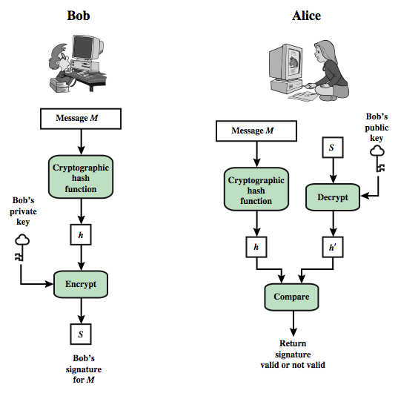
Digital Signature Model
Notes:
In simplified terms, the essence of the digital signature mechanism is shown in Stallings Figure 13.2. This repeats the logic shown in Figure 11.3. On example, using RSA, is available at this book's Web site.
We begin this chapter with an overview of digital signatures. Then, we introduce the Digital Signature Standard (DSS).
15

Slide 16
Digital Signature Properties
Signatures depend on the message signed
It uses information unique to sender, to prevent both forgery and denial
Signature creation/verification are efficient
It is computationally infeasible to forge
with new message for existing digital signature
with fraudulent digital signature for given message

Slide 17

ElGamal Digital Signature
By Taher ElGamal, in 1984
It operates in a finite field
Security is based on difficulty of computing discrete logarithm, as in D-H Taher Elgamal
Each user (eg. A) generates his/her own key
Chooses a secret key: 1 < x_{A} < q-1
Compute their public key: y_{A} = a^{xA} mod q
Notes:
17
Recall from Chapter 10, that in 1984, T. Elgamal announced a public-key scheme based on discrete logarithms, closely related to the Diffie-Hellman technique [ELGA84, ELGA85]. The ElGamal encryption scheme is designed to enable encryption by a user's public key with decryption by the user's private key. The ElGamal signature scheme involves the use of the private key for encryption and the public key for decryption. The ElGamal cryptosystem is used in some form in a number of standards including the digital signature standard (DSS) and the S/MIME email standard. As with Diffie-Hellman, the global elements of ElGamal are a prime number q and a, which is a primitive root of q. User A generates a private/public key pair as shown. The security of ElGamal is based on the difficulty of computing discrete logarithms, to recover either x given y, or k given K (next slide).

Slide 18
ElGamal Signature
Alice signs a message M to Bob by computing
The hash m = H(M), 0 ≤ m ≤(q-1)
Choose random integer K with 1 ≤ K ≤(q-1) and gcd(K,q-1)=1
Compute the value: S₁ = a^{k} mod q
Compute K⁻¹ the inverse of K mod (q-1)
Compute the value: S₂ = K⁻¹(m-x_{A}S₁) mod (q-1)
Signature is: (S₁,S₂)
Any user B can verify the signature by computing
V₁ = a^{m} mod q
V₂ = y_{A}^{S1} S₁^{S2} mod q
Signature is valid if V₁ = V₂
Notes:
18
To sign a message M, user A first computes the hash m = H(M), such that m is an integer in the range 0 <= m <= q – 1. A then forms a digital signature as shown.
The basic idea with El Gamal signatures is to again choose a temporary random signing key, protect it, then use it solve the specified equation on the hash of the message to create the signature (in 2 pieces). Verification consists of confirming the validation equation that relates the signature to the (hash of the) message (see text for proof). Again note that El Gamal encryption involves 1 modulo exponentiation and multiplications (vs 1 exponentiation for RSA).

Slide 19
ElGamal Signature Example
Use field GF(19) q=19 and a=10
Alice computes her key:
A chooses x_{A}=16 & computes y_{A}=10¹⁶ mod 19 = 4
Alice signs message with hash m=14
choosing random K=5 which has gcd(18,5)=1
computing S₁ = 10⁵ mod 19 = 3
finding K⁻¹ mod (q-1) = 5⁻¹ mod 18 = 11
computing S₂ = 11(14-16.3) mod 18 = 4
Any user B can verify the signature by computing
V₁ = 10¹⁴ mod 19 = 16
V₂ = 4³.3⁴ = 5184 = 16 mod 19
Since 16 = 16 signature is valid
Notes:
19
Here is an example of creating and verifying an ElGamal signature from the text using the prime field GF(19); that is, q = 19. It has primitive roots {2, 3, 10, 13, 14, 15}, as shown in Table 8.3. We choose a = 10. Alice generates a key pair as shown, which is = {19, 10, 4}. Alice can sign a message with hash m = 14 as shown to compute the signature pair (3,4). Any user B can verify the signature by computing confirming the validation equation as shown.

Slide 20
Digital Signature Standard (DSS)
The standard DSS was approved by US government, and published in 1991
Designed by NIST & NSA in early 90's
Revised in 1993, 1996, & 2000
The core signature algorithm is called Digital Signature Algorithm (DSA)
Is a variant of ElGamal scheme
Hash algorithm is based on the SHA
Notes:
20
DSA is the US Govt approved signature scheme, which is designed to provide strong signatures without allowing easy use for encryption. The National Institute of Standards and Technology (NIST) published Federal Information Processing Standard FIPS 186, known as the Digital Signature Standard (DSS). The DSS makes use of the Secure Hash Algorithm (SHA) described in Chapter 12 and presents a new digital signature technique, the Digital Signature Algorithm (DSA). The DSS was originally proposed in 1991 and revised in 1993 in response to public feedback concerning the security of the scheme. There was a further minor revision in 1996. In 2000, an expanded version of the standard was issued as FIPS 186-2. This latest version also incorporates digital signature algorithms based on RSA and on elliptic curve cryptography. In this section, we discuss the original DSS algorithm. The DSS uses an algorithm that is designed to provide only the digital signature function. Unlike RSA, it cannot be used for encryption or key exchange. Nevertheless, it is a public-key technique.

Slide 21
DSA Key Generation
Global public key values (p, q, g)
Choose 160-bit prime number q
Choose a large prime p with 2^{L-1} < p < 2^{L}
where L= 512 to 1024 bits and is a multiple of 64
such that q is a prime divisor of (p-1)
Choose g = h^{(p-1)/q}
where 1<h<p-1 and h^{(p-1)/q} mod p > 1
Users choose private key & compute public key
Choose random private key: x<q
Compute public key: y = g^{x} mod p
Notes:
21
DSA typically uses a common set of global parameters (p,q,g) for a community of clients, as shown. A 160-bit prime number q is chosen. Next, a prime number p is selected with a length between 512 and 1024 bits such that q divides (p – 1). Finally, g is chosen to be of the form h^{(p–1)/q} mod p where h is an integer between 1 and (p – 1) with the restriction that g must be greater than 1. Thus, the global public key components of DSA have the same for as in the Schnorr signature scheme.
Then each DSA uses chooses a random private key x, and computes their public key as shown. The calculation of the public key y given x is relatively straightforward. However, given the public key y, it is computationally infeasible to determine x, which is the discrete logarithm of y to base g, mod p.

Slide 22
DSA Signature Creation
To sign a message M the sender:
generates a random signature key k, k<q
Note: k will be destroyed after use, and never be reused
Then computes signature pair:
r = (g^{k} mod p)mod q
s = [k⁻¹(H(M)+ xr)] mod q
Sends signature (r,s) with message M
Notes:
22
To create a signature, a user calculates two quantities, r and s, that are functions of the public key components (p,q,g), the user’s private key (x), the hash code of the message H(M), and an additional integer k that should be generated randomly or pseudo-randomly and be unique for each signing. This is similar to ElGamal signatures, with the use of a per message temporary signature key k, but doing calculations first mod p, then mod q to reduce the size of the result. The signature (r,s) is then sent with the message to the recipient. Note that computing r only involves calculation mod p and does not depend on message, hence can be done in advance. Similarly with randomly choosing k’s and computing their inverses.

Slide 23
DSA Signature Verification
Having received M & signature (r,s)
To verify a signature, recipient computes:
w = s⁻¹ mod q
u1= [H(M)w ]mod q
u2= (rw)mod q
v = [(g^{u1} y^{u2})mod p ]mod q
If v=r then signature is verified
Notes:
23
At the receiving end, verification is performed using the formulas shown. The receiver generates a quantity v that is a function of the public key components, the sender’s public key, and the hash of the incoming message. If this quantity matches the r component of the signature, then the signature is validated. Note that the difficulty of computing discrete logs is why it is infeasible for an opponent to recover k from r, or x from s. Note also that nearly all the calculations are mod q, and hence are much faster save for the last step.
The structure of this function is such that the receiver can recover r using the incoming message and signature, the public key of the user, and the global public key. It is certainly not obvious that such a scheme would work. A proof is provided in Stallings appendix K.

Slide 24
Summary
Have studied:
Hash Functions
Digital signatures
Digital signature algorithm
Digital signature standard

Slide 25
Next Lecture
Electronic Mail Security..

Slide 26

Questions?

